Slide 1
PRODUCT DEVELOPMENT LABORATORY Department of Computer Science and Engineering NIT ROURKELA
Title: Machine Reading Comprehension
MID SEM EVALUATION PRESENTATION

Slide 2
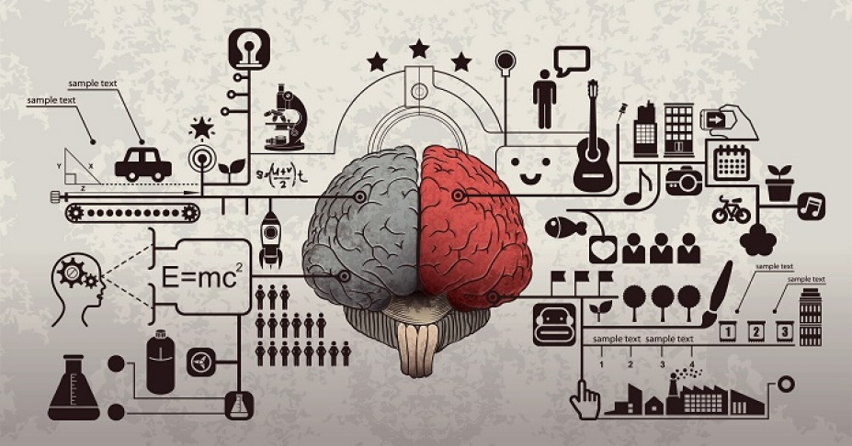
MACHINE READING COMPREHENSION
Reading paragraphs, understanding the related questions and answering them has always been a difficult task for the machines.
It is only the capability of humans to understand the logic and meaning of the question and answer it to maintain a proper mode of interaction.
But for machines, this is a quite complex task

Slide 3
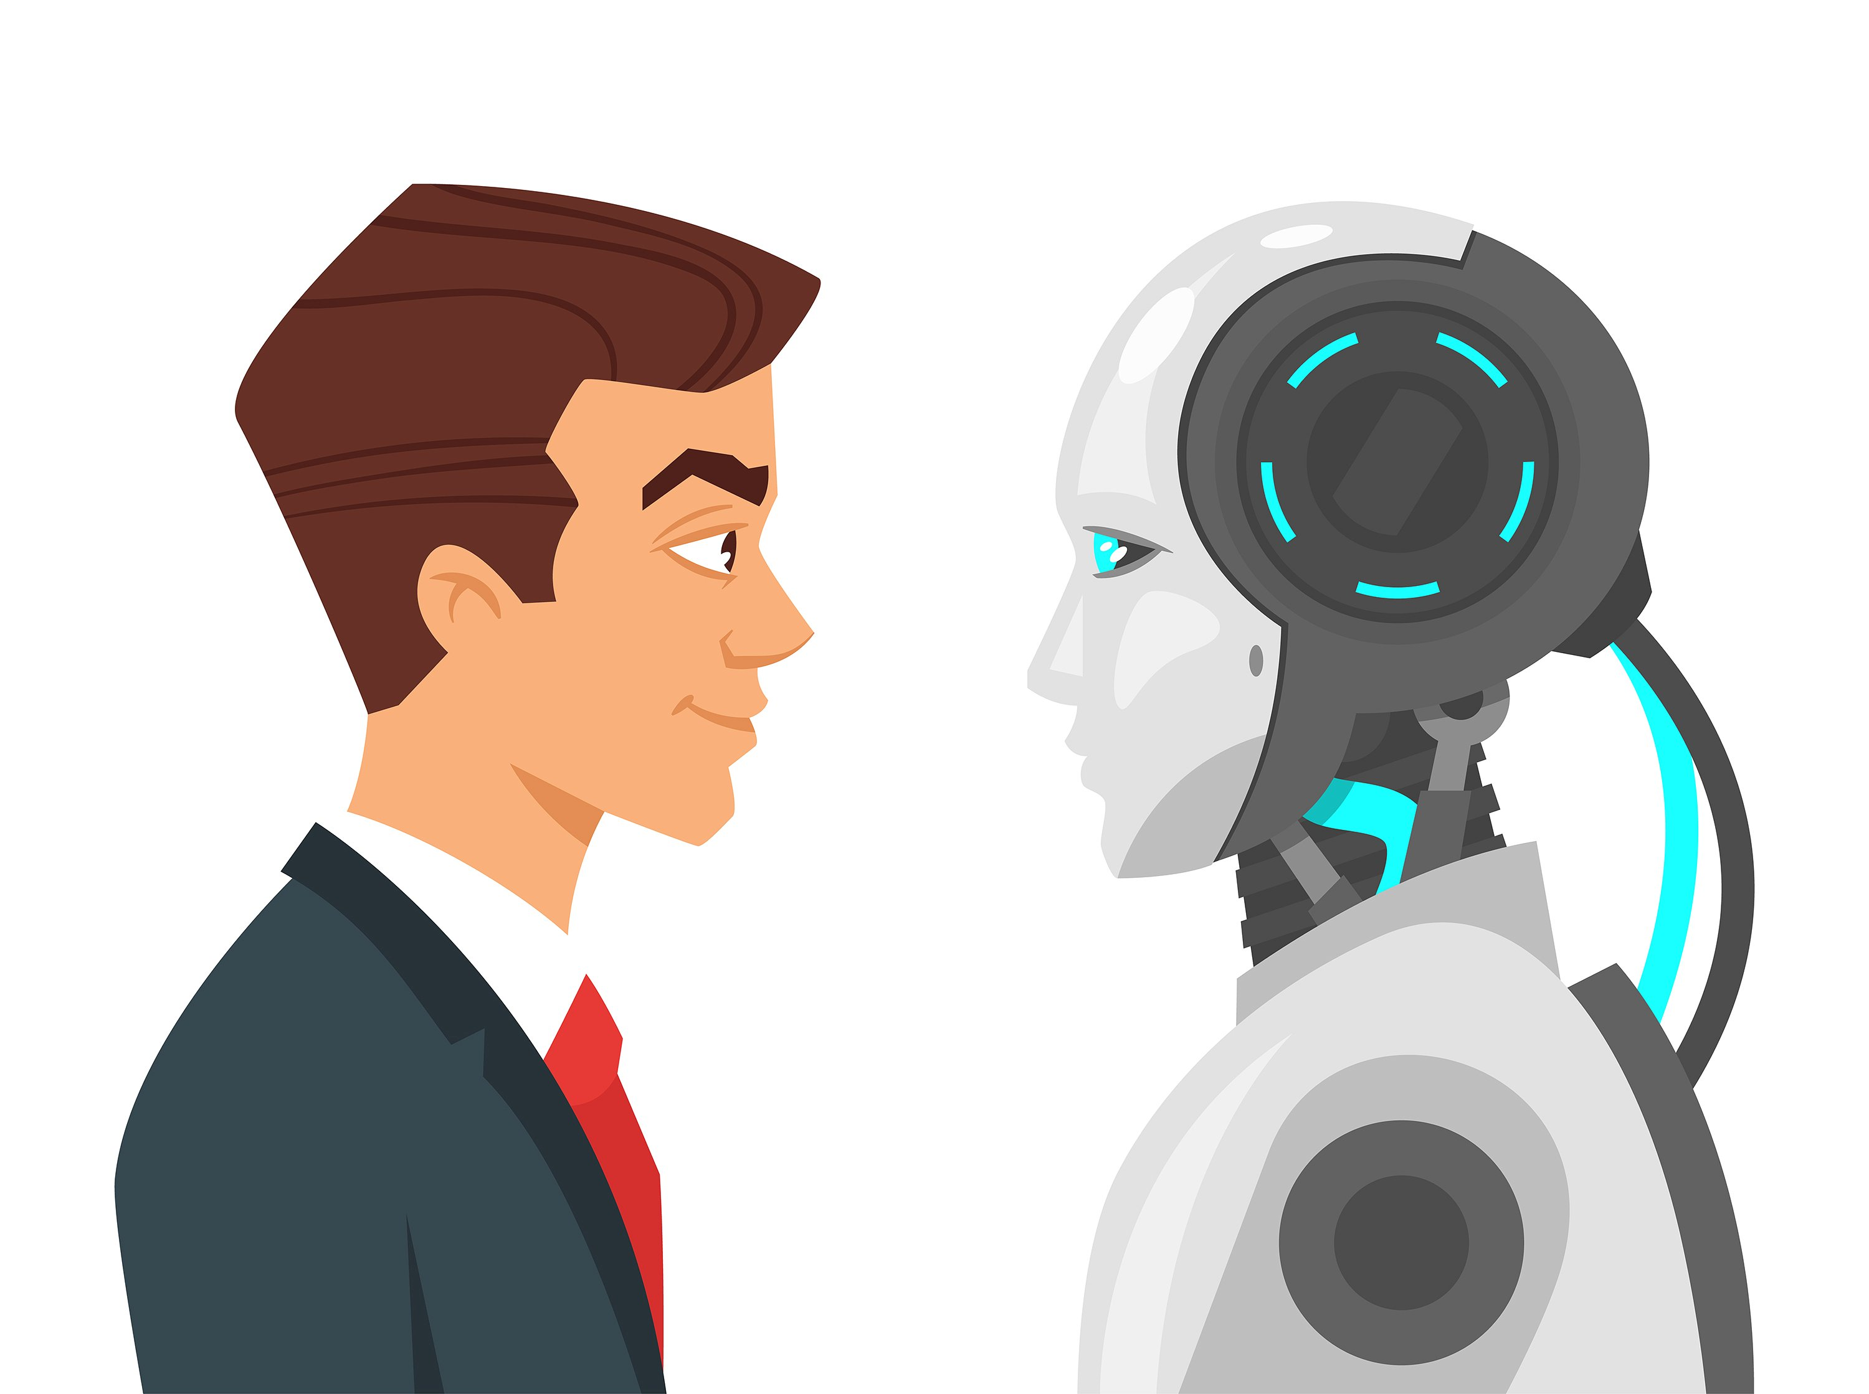
Humans Vs Machine
The basic way of answering the questions that follow the paragraph is that we read the question, try to search for the answer from the paragraph with the help of matched words of questions and paragraph.
But imagine a machine given a passage to learn and understand and then answer the questions.
Machine tries to capture nested context in a paragraph, i.e., the subject, the predicate, the concept and the conditions from the question.
MRC model is the solution.
The model works on the principles of Word Embeddings, Neural Network Attention, Bi-Directional Recurrent Neural Networks.

Slide 4
GOAL OF THE PROJECT
The goal is to train a machine to understand a given passage and then answer the questions related to the passage.
MACHINE
PASSAGE WITH QUESTIONS
ANSWERS

Slide 5
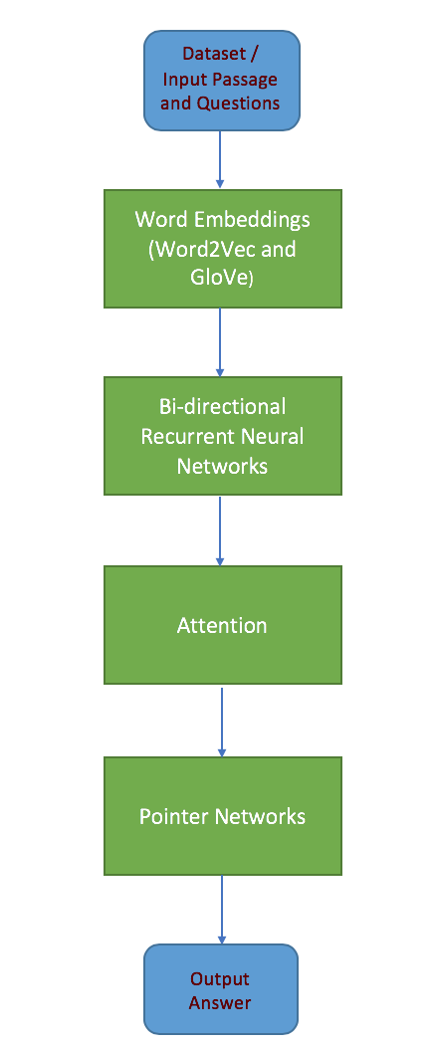
FLOWCHART OF THE WORKFLOW
The model utilizes
Word embeddings
Bidirectional Recurrent Neural Networks (Bi RNN)
Attention in neural networks to highlight some part of the text under the context of the other.
Pointer Networks.

Slide 6
RELATED WORK
Earlier models used One Hot Encoding method to represent words.
The paper presented by Wissam Baalbaki and Dan Zylberglejd entitled “Natural Language Processing with deep reading comprehension” used Word Embeddings to represent the words.
Attention mechanism has also been used in comprehension models.
The paper entitled “A Fully Attention based Information Retriever” used attention based mechanism to visualize the passage and question together.

Slide 7
So What’s New??
We use GRU cells, a variation of LSTM cells used in RNNs.
We also use Self Matching Attention to relate the question with the passage.

Slide 8
What is SQuAD ?
Stanford Question Answering Dataset (SQuAD) is a reading comprehension dataset, consisting of questions posed by crowdworkers on a set of Wikipedia articles.
The answer to every question is a segment of text or span from the corresponding reading passage.
Some of the question might be unanswerable.
The SQuAD dataset utilizes python data structures – nested dictionaries and nested lists.

Slide 9
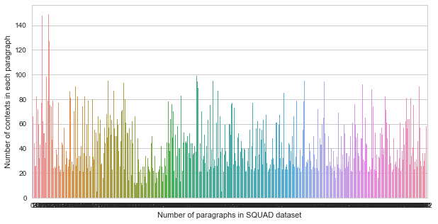
DATA ANALYSIS
SQuAD training set consists of 442 titles with varying number of paragraphs in each title

Slide 10
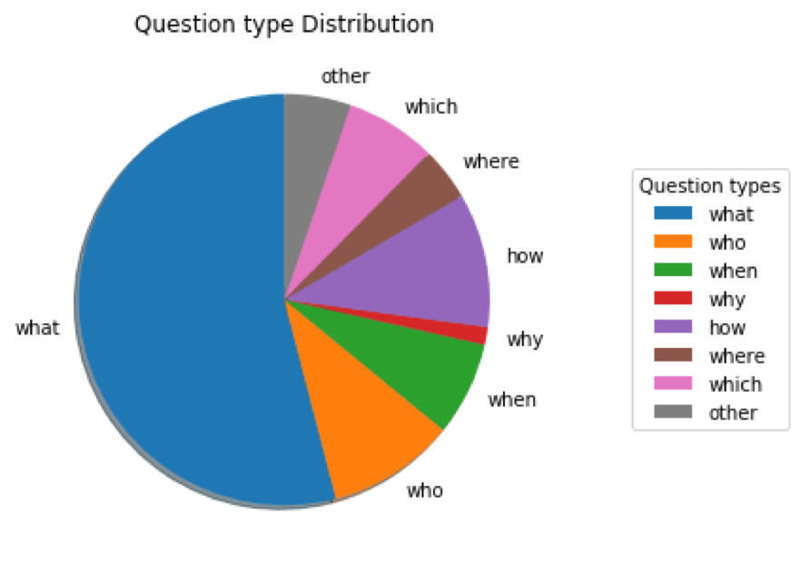
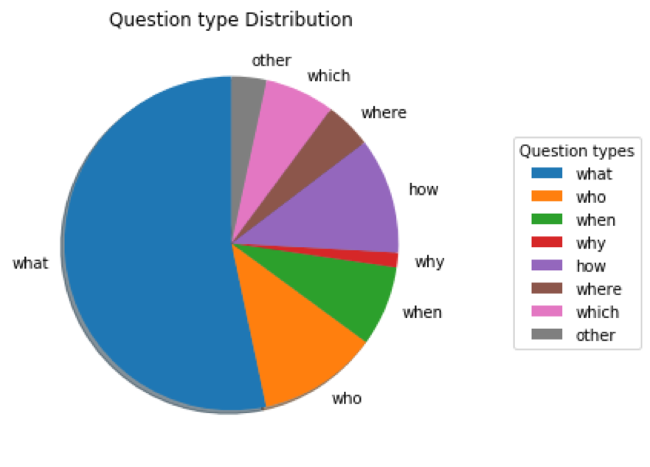
TRAIN SET Vs TEST SET
Distribution of question type
in train set
Distribution of question type
in test set

Slide 11
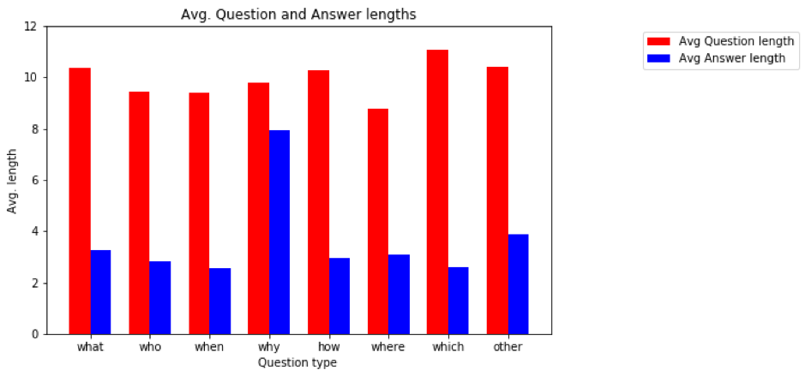
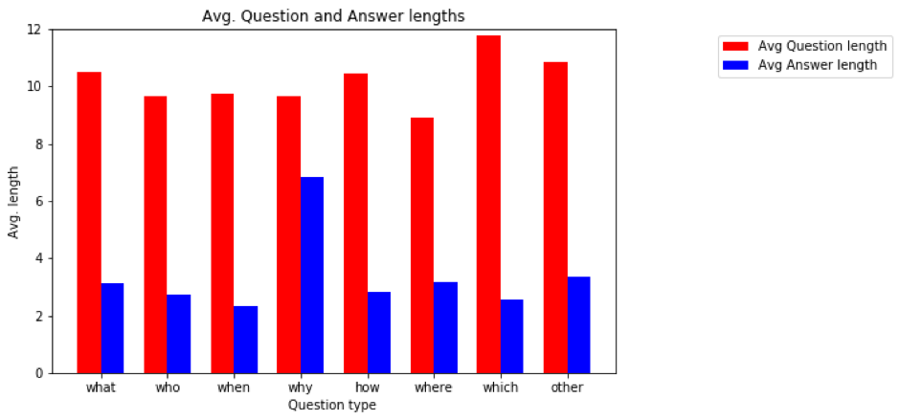
TRAIN SET Vs TEST SET
Average length of Questions and Answers
in training set
Average length of Questions and Answers in test set

Slide 12
STATISTICAL ANALYSIS OF THE DATASET
S no | Statistical aspect | Train set | Test set
1 | Title count | 442 | 48
2 | Total word count | 91,87,544 | 10,93,051
3 | Total Question count | 87,599 | 10,570
4 | Context count | 18,896 | 2,067
5 | Avg Question length | 10.46 | 10.82
6 | Avg Answer length | 3.26 | 3.15
7 | Avg Context length | 117 | 123
8 | Avg Question count per context | 4.64 | 5.11

Slide 13
Inference
In the training set, the major number of questions are of ”WHAT” type and least number of questions are of ”HOW” type.
The test dataset follows almost similar type of question distribution as the training set.
Seven types of questions were taken into consideration and rest of the questions were considered as other type.
The WHY type of questions have much higher answer length than the rest of questions and the same was observed in the test set.

Slide 14
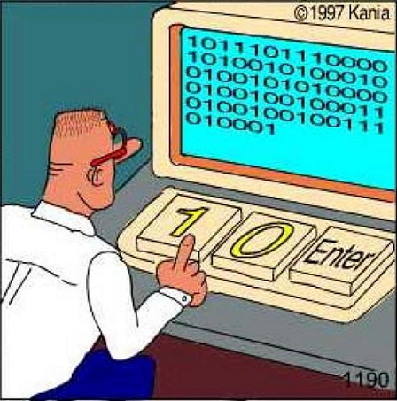
ONE HOT ENCODING
Machine only understand in binary, i.e., only 0s and 1s
So we need to convert the words in the dataset to mathematical form.
Naïve approach for this problem is to apply one hot encoding method on the entire dictionary of words.
For example, if we have 5 words in our dictionary, they can be represented as :
W1 -> 10000
W2 -> 01000
W3 -> 00100
W4 -> 00010
W5 -> 00001

Slide 15
ONE HOT ENCODING
Drawbacks of this representation:
Since we have millions of words in English dictionary, each word requires huge memory, which is practically infeasible.
This representation significantly slows down the efficiency of the model.
There is no way to group words of similar meaning together.

Slide 16
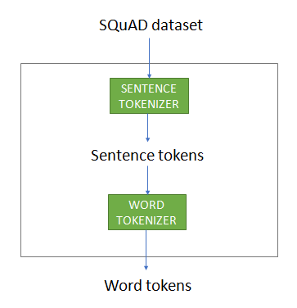
WORD EMBEDDINGS
A simple and efficient solution to this problem is word embeddings.
It is a technique in NLP where words are mapped to vectors in a fixed dimensional space.
Each word is represented with a vector of fixed number of dimensions (50, 100, 300)
Each feature is a real value in the range [-1,1].
Similar words have similar representation.
One of the word embedding algorithms is “GloVe”.

Slide 17
GloVe
GloVe stands for Global Vector for word representation.
This is an unsupervised algorithm for obtaining vector representation of words.
It is a count based model that learns vectors or words from their co-occurrence information.
These are vectors which can be trained on SQuAD dataset.
It achieves better results faster.
To obtain similarity between two words mathematically, we use “Cosine Similarity” measure.

Slide 18
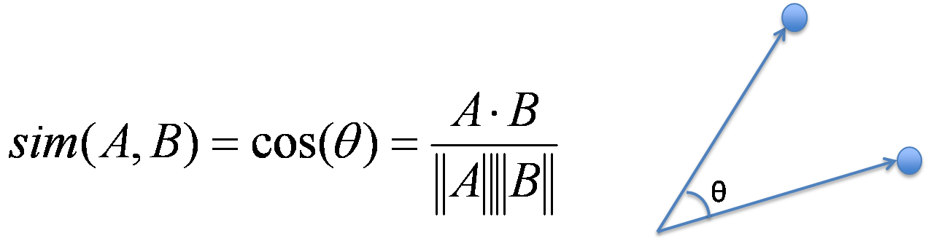
COSINE SIMILARITY
Cosine similarity is calculated based on the angle between the two vectors.
It measures the cosine of the angle between the two vectors projected in a multi-dimensional space.
Cosine Similarity values lie in the range [-1, 1].
It can be found using the formula

Slide 19
Cosine Similarity as per context of paragraphs of dataset
S no | Word1 | Word2 | Cosine Similarity
1 | Cricket | Football | 0.666
2 | Cricket | Sport | 0.485
3 | Banana | Mango | 0.705
4 | Fruits | Sports | 0.077
5 | Football | Banana | 0.142
6 | Bat | Ball | 0.693
7 | College | School | 0.885
8 | Pen | Pencil | 0.610

Slide 20

APPLICATIONS
Speech-to-text translation.
Text Summarization.
Chat bots in help desks.

Slide 21
THANK YOU

